Slide 1

Bridging the Divide: Data-Driven Equity for Victorian state Schools
DATA6000 – Capstone: Industry Case Studies
Aayush Purohit
1850846
Notes:
"Good afternoon. I'm here to talk about a silent crisis in our education system. While all Victorian children deserve an equal start, our data reveals a severe and worsening funding gap. Metro schools consistently raise two to three times more in voluntary contributions than regional schools. This isn't just about extra perks; it's about basic resources like technology, materials, and specialist staff. This divide is actively widening, threatening the principle of equitable public education.”
or
Right now, we have a system where a student's educational resources are determined by their postcode, not their potential. My project provides the data-driven blueprint to fix this. It’s not just about equity; it’s about maximizing the return on our public investment in education."

Slide 2

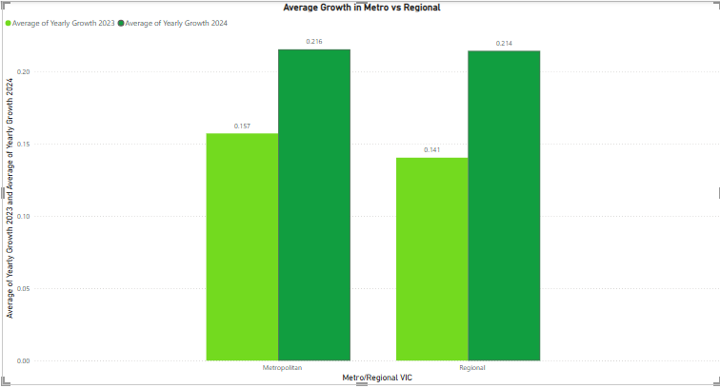
Victoria's Public Schools Are Facing a Widening $100M+ Equity Gap
THE CRISIS & THE DATA
The Problem:
Voluntary parent contributions create a two-tiered public school system.
Our data analysis (2022-2024) proves metro schools raise 2-3x more than regional schools.
This gap isn't static—it's growing every year, cementing disadvantage.
The Question: How do we ensure a child's education isn't determined by their postcode?
Growth in Metro vs Regional in 2023 & 24’
Notes:
This isn't just an inequality issue; it's a $100 million-plus efficiency problem. We are systematically under-investing in the potential of regional students, and the data proves the gap is accelerating. This isn't a slow drift; it's a divergence that locks in disadvantage for an entire generation."
"Look at the trend. Metro schools are on a high-growth trajectory. Regional schools are flatlining. If this line <point to regional trend> doesn't change, we are knowingly committing to a future of two-tiered education. But here's the key insight: this is predictable."

Slide 3
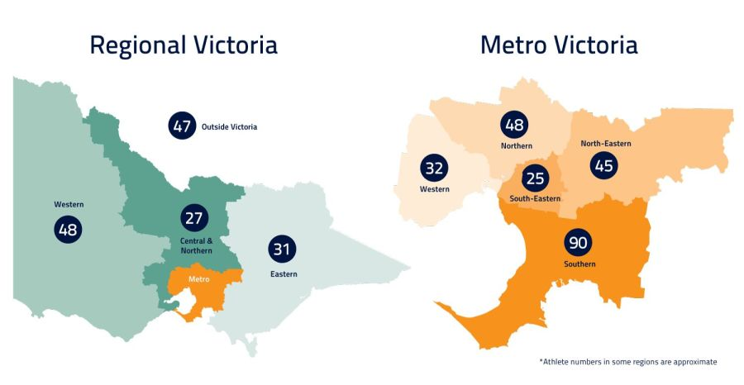
Findings:
Our predictive model, with 92% accuracy, confirms location and school size are the key drivers—not just socio-economics.
This means the problem is predictable and therefore solvable with targeted policy.
Recommendation:
Implement a dynamic, needs-based funding top-up for identified high-need schools.
Use our geospatial model to direct resources strategically and a dashboard to ensure transparency.
The Root Cause & Our Solution
Notes:
We used advanced analytics to move beyond describing the problem to solving it. Our regression model, which is over 92% accurate, shows that a school's postcode is a primary determinant of its resources. This gives us a clear actionable lever. We propose a smarter funding model that uses this data to automatically provide a top-up to the schools that need it most, ensuring funding follows need, not just privilege.”
Or
Our model, with 92% accuracy, doesn't just describe the problem—it diagnoses it. We can now pinpoint exactly which schools and regions will fall behind, based on location and size. This means we can stop reacting and start preventing.
So, our solution is surgical. We propose a dynamic funding top-up, a strategic injection of capital directed by this model to the schools we know need it most. This isn't a blanket handout; it's a targeted investment to level the playing field. We pair this with a public dashboard to ensure every dollar is accounted for, creating unprecedented transparency."

Slide 4


Let's Build a Truly Equitable Education System
The Impact:
Level the playing field for every Victorian student.
Break the cycle of geographic disadvantage.
Maximize the return on public education investment.
The Ask:
Support to present these findings to the Department of Education.
Partner to pilot this data-driven funding model in the most affected regions.
Notes:
The impact of acting on these insights is profound: equitable resources, fair opportunities, and a stronger future for all our children. We have the data, the analysis, and the blueprint. We are seeking your support to turn this research into action. With your backing, we can present this to policymakers and pilot a solution that closes the gap for good. Let's invest in a data-driven solution that ensures every child, no matter where they live, has the tools to succeed. Thank you." or
The outcome? We stop the gap from widening. We give every student a fair shot. And we transform education funding from a blunt instrument into a precision tool. This is no longer an insurmountable social problem—it's a solvable data problem. Let's not just talk about equity; let's engineer it. Thank you."

Slide 5

Thank You

